Slide 1
Science
Scientists and Inventors
Year One
Science | Year 2 | Scientists and Inventors | Charles Macintosh | Lesson 5

Slide 3
Aim
I can describe Charles Macintosh and his famous invention.
I can investigate the most suitable materials for a particular use.
Success Criteria
I can give facts about Charles Macintosh.
I can describe Macintosh’s famous invention.
I can test materials to find out how waterproof they are.
I can choose the best materials for a new waterproof coat.

Slide 4
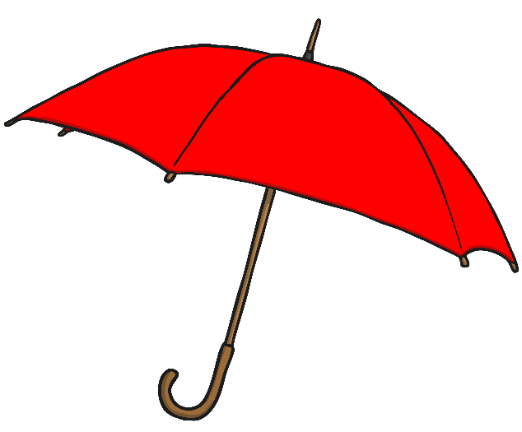
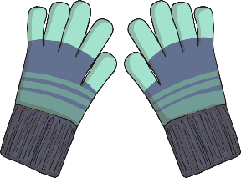
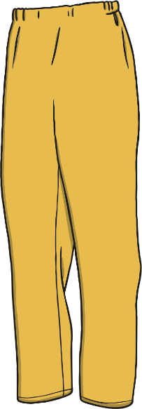
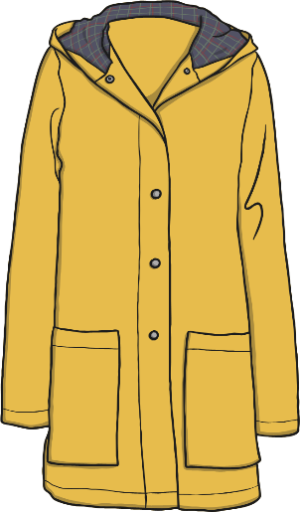
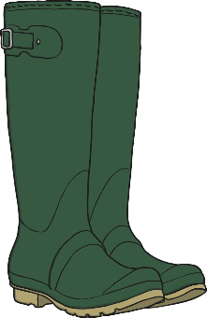
Wet Weather Wear
When it is raining, people wear special wet weather clothes.
Which of these items would you use or wear in the rain?
Think about the things they are made from. What do they have in common?

Slide 5
Charles Macintosh
The clothes that people wear to protect them from the rain are waterproof.
Waterproof fabric was invented by a scientist called Charles Macintosh.
His invention was so important that raincoats are named after him!
Raincoats are called Mackintoshes, or macs.

Slide 6
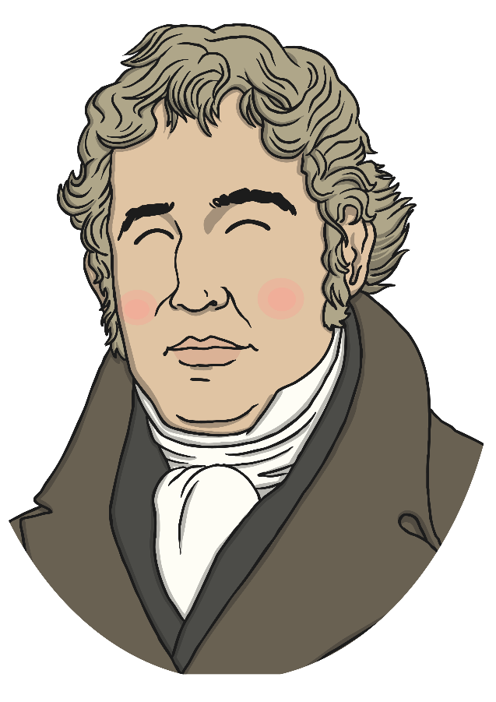
Charles Macintosh
Charles Macintosh was born in 1766 in Scotland.
As a young man he worked as a clerk,
keeping records and doing paperwork. He did not
love this job though, and in his spare time he
studied science.
Charles left his job as a clerk when he was 19.
He started work manufacturing chemicals, and
experimented with ways to use chemicals to
make new materials.

Slide 7
Charles Macintosh
During one of his experiments, he found that rubber would dissolve into a
liquid in naphtha, a product derived from coal tar that he was investigating.
The dissolved liquid rubber was waterproof.
Charles realised it could be used to make
waterproof fabric for clothes.
He painted the dissolved rubber onto a piece
of woollen cloth and placed another piece of
woollen cloth on top, so the rubber was
sandwiched in the middle.
Charles had invented waterproof fabric!
He started to use this fabric to make waterproof coats that he called
Mackintoshes.

Slide 8
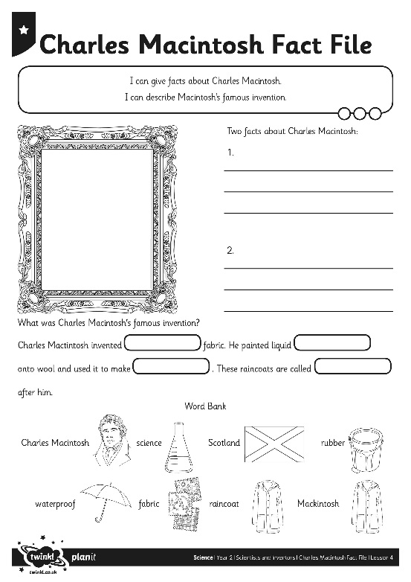
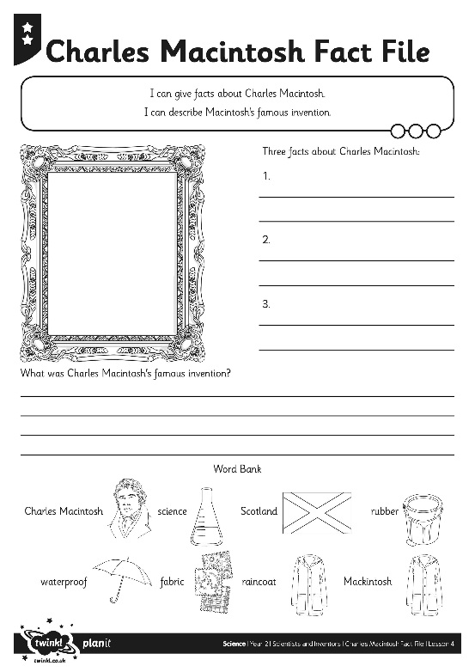
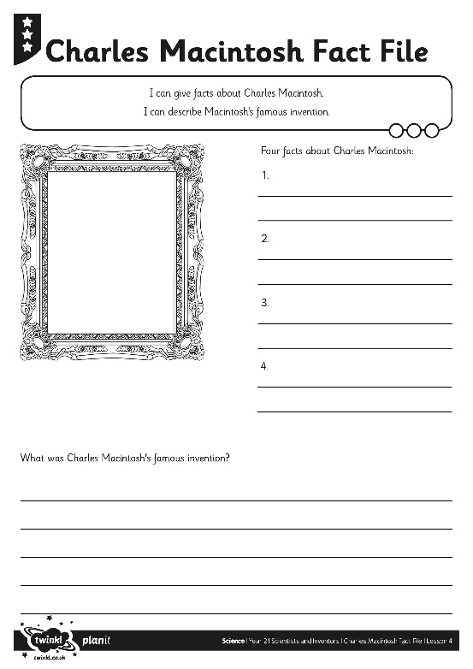
Macintosh Fact File
Complete the Charles Macintosh
Fact File with information about his
life and his famous invention.

Slide 9
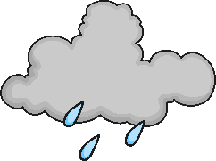
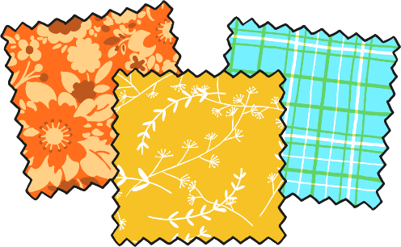
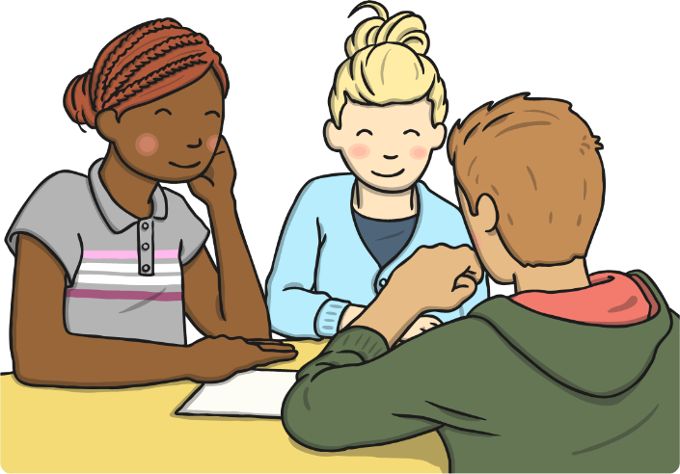
Waterproof Coat Test
This is Harley. He needs a new raincoat to keep him dry in
the rainy weather.
You need to find the best
material to use to
make his new coat.
Work as a group to test
the different fabrics and
sheets.

Slide 10
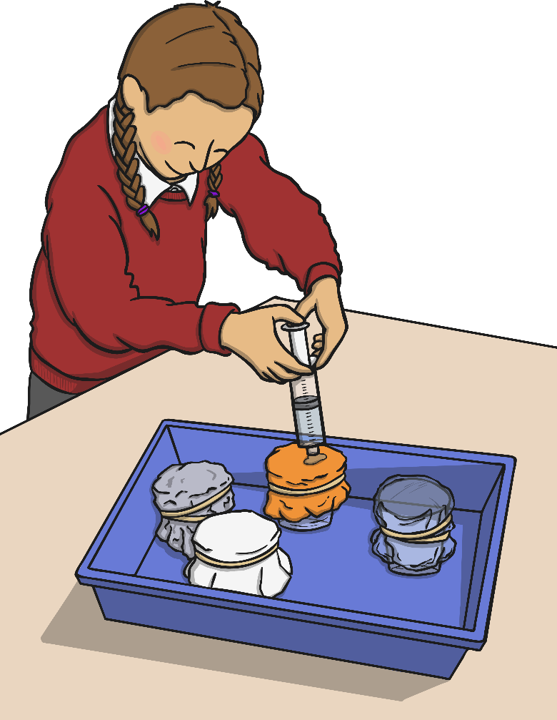
Waterproof Coat Test
You will have a selection of different
different things stretched over some
beakers. Place the beakers in a tray so
that you don't get everything wet!
Fill a syringe with water and squeeze it
onto each item.
If the water drips through into the
beaker, the material is not
waterproof.
If the water stays on top, the material is
waterproof.

Slide 11
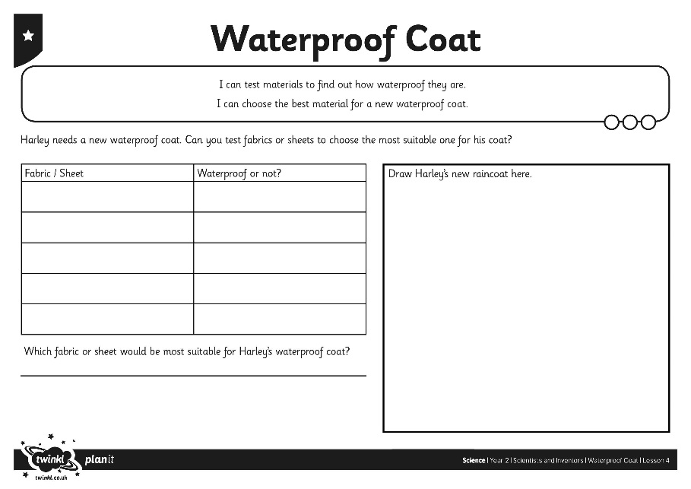
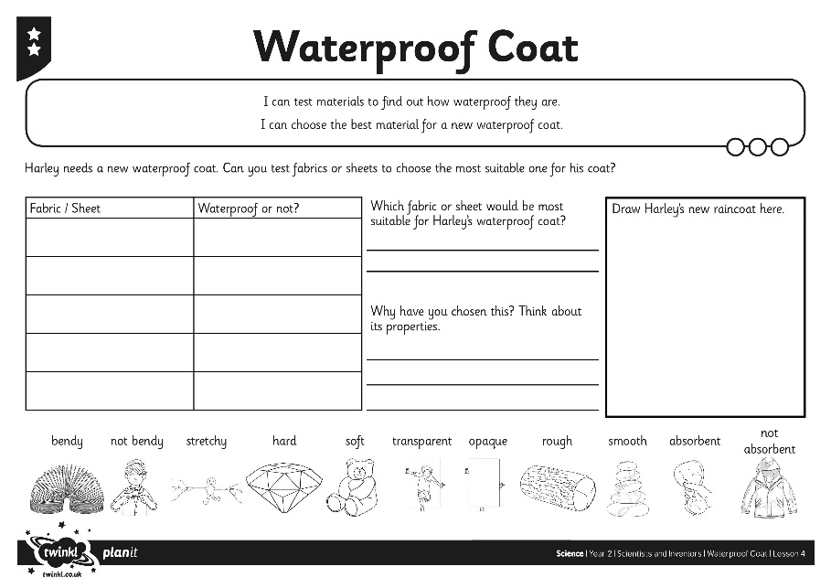
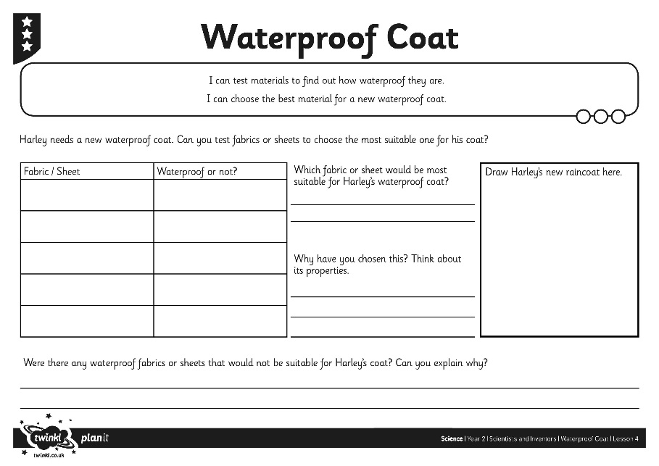
Design the Waterproof Coat
Record your results on your Waterproof Coat Activity Sheet. When you have
finished, use your results to choose the most suitable material for
Harley's coat.

Slide 12
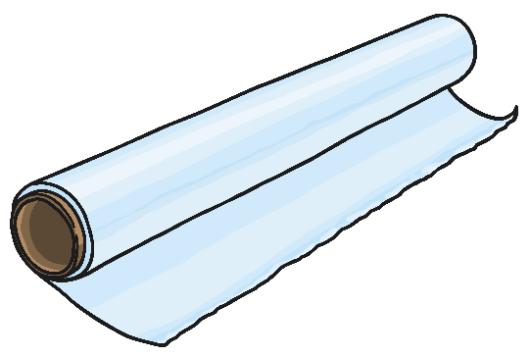
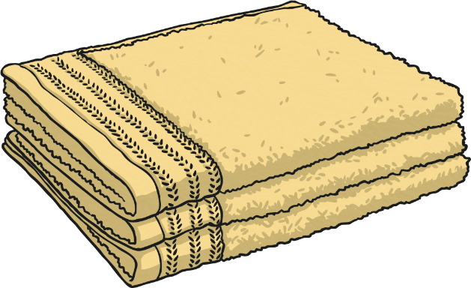
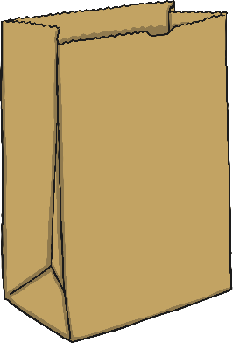
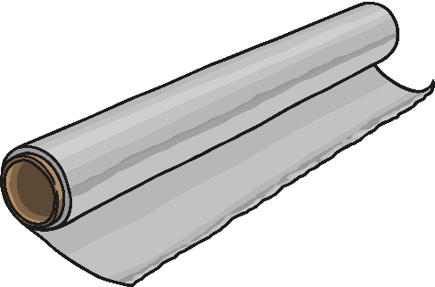
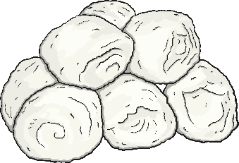
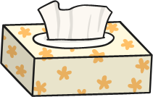
Materials
The different things you tested are all made from
different materials.
For example, the cling film sheet is made from plastic.
What are the other things that you tested made from?

Slide 13
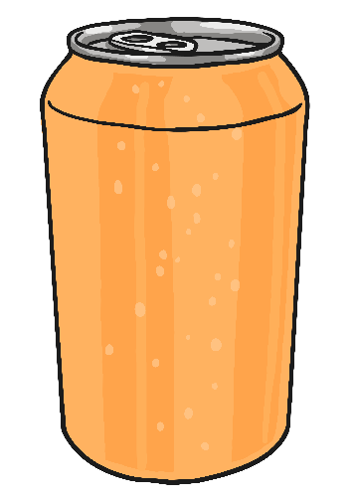
Unsuitable Materials
Materials are chosen for particular uses based on their properties. Charles
Macintosh created a fabric that was waterproof and flexible, so it could be used
to make clothes.
A sheet of tinfoil is made from aluminium. This is a waterproof metal. Why
would this not be a good choice of material for a waterproof coat?
Think about its other properties.

Slide 14
Aim
I can describe Charles Macintosh and his famous invention.
I can investigate the most suitable materials for a particular use.
Success Criteria
I can give facts about Charles Macintosh.
I can describe Macintosh’s famous invention.
I can test materials to find out how waterproof they are.
I can choose the best materials for a new waterproof coat.

