Slide 1
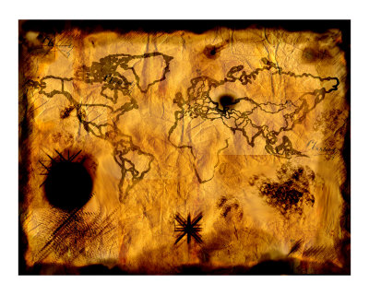
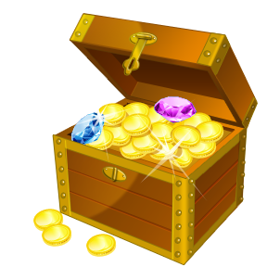
Your journey across Treasure Island

Slide 2

Approaching the Island
What do you see?
How do you feel?

Slide 3
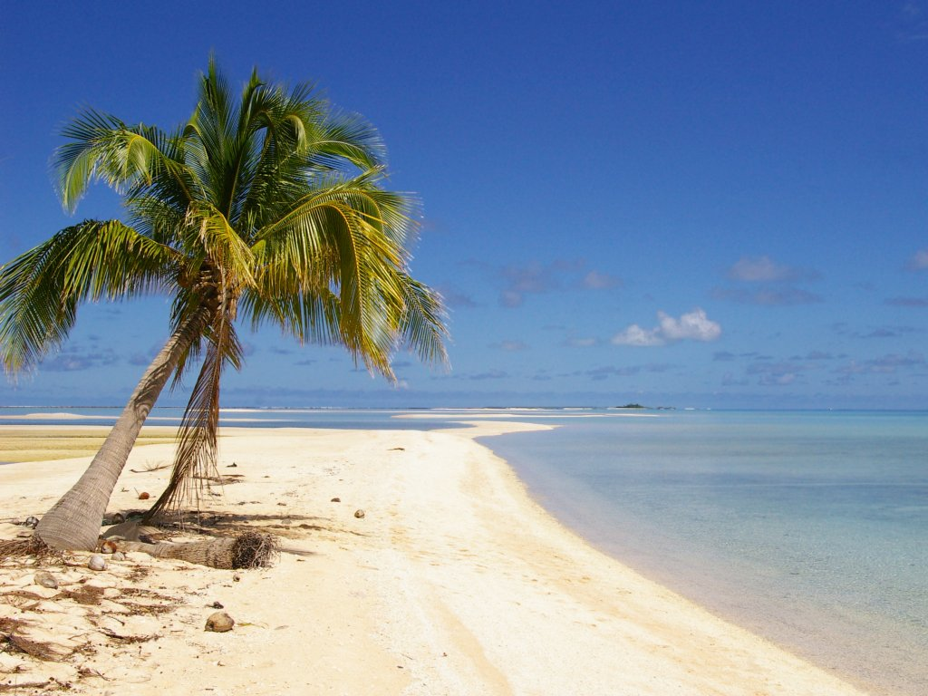
Landing on the beach
What do you hear?
Pick up a shell!

Slide 4
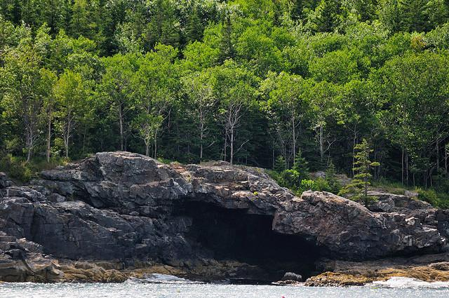
The dark cave

Slide 5
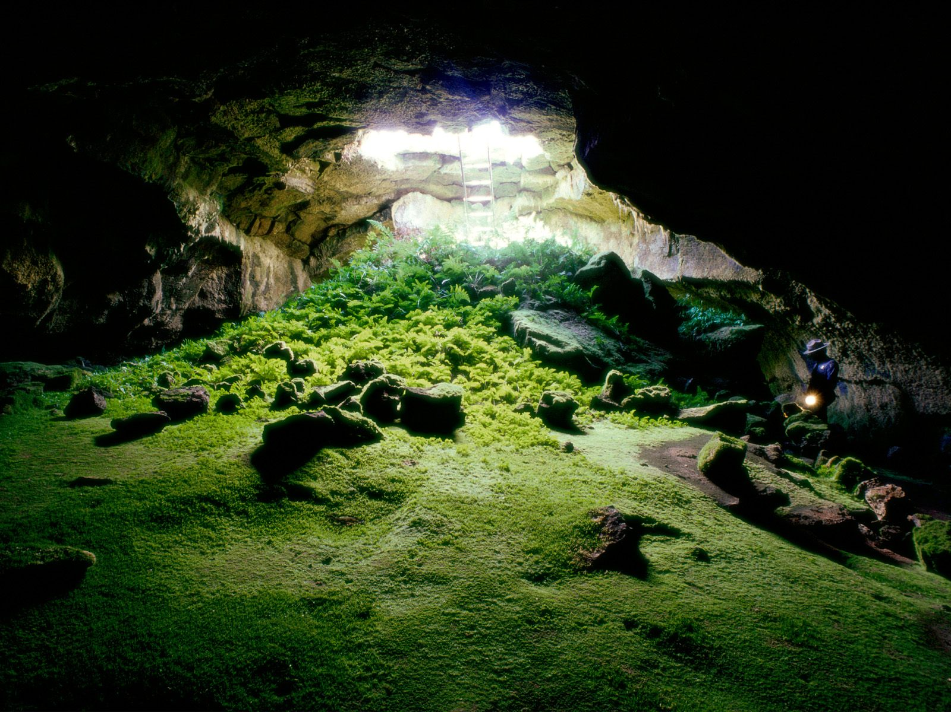
Inside the cave
Use your lantern…what do you see?

Slide 6
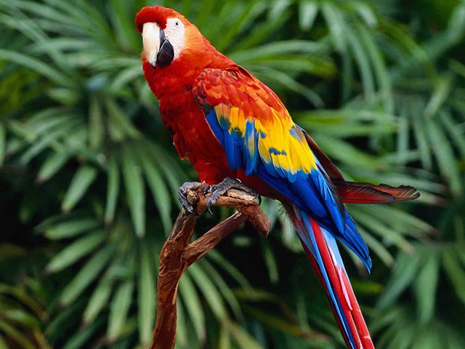
Through the forest, see the colourful parrots
Can you hear them?

Slide 7

Avoid kidnap at the pirate’s hut
How do you feel?

Slide 8
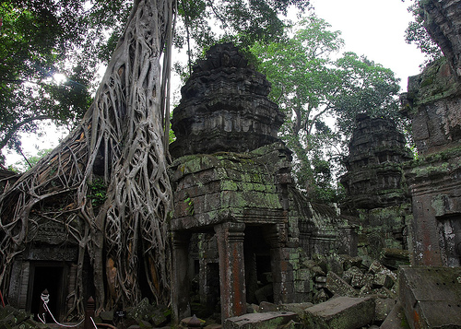
Pass carefully through the ancient ruined temple
How are you feeling?

Slide 9
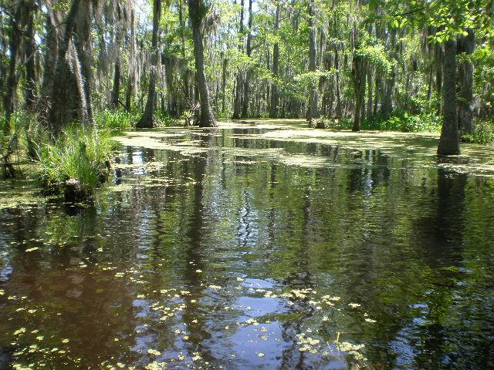
Cross the swamp
What can you smell?
Use the rope to swing across!

Slide 10
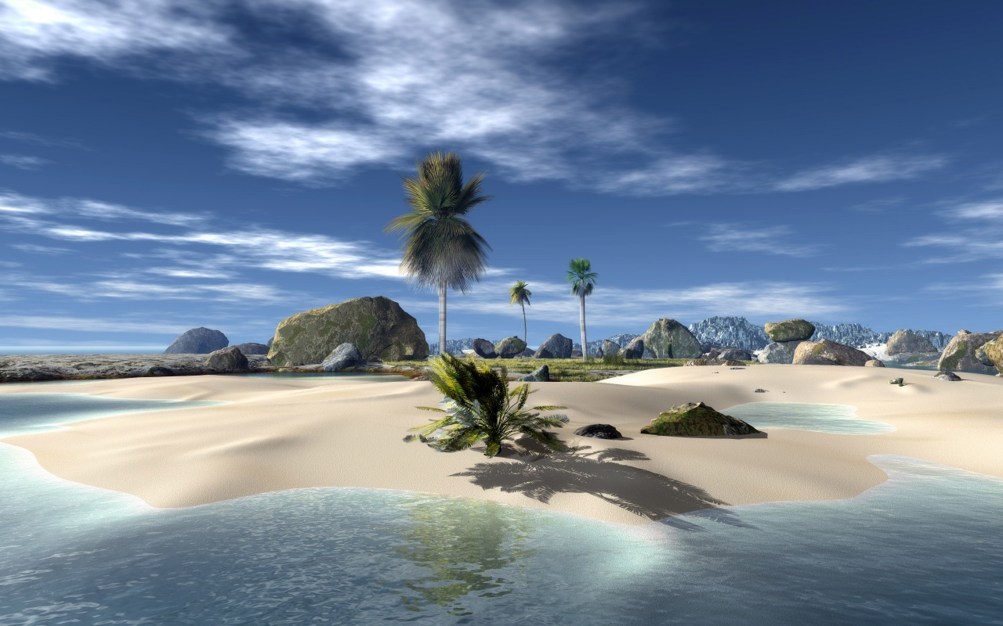
You’re nearly there...where is the treasure?

